Slide 1
Online Photo Library
Wiki Link:-
https://github.com/ag58884n/project
https://github.com/Amrit-choudhary16/Project
Video Link:-
https://www.youtube.com/watch?v=SJpiLShuw-Q
Aditya gajjar
Amrit Choudhary

Slide 2

Description of the problem: -
Applications such as Google Photo does not allow the user to assign a tag to their photos. The tagging is done automatically in such apps by accessing the user’s uploaded photos. In such cases the privacy of the user is at risk.
These days it is difficult to retrieve or transfer photographs when people change their devices or the platform on which they operate.
On using similar applications we understood the reason why most of the online photo library are not successful, it is mainly because of the complicated UI design which makes it difficult for the user to get hang of the app.

Slide 3

Research about the application
In order to begin our research we started using the application that are currently in the market. We analyzed the applications and worked on resolving the existing complications.
We referred to our course material, certain youTube videos and many other google based links that helped us understand and implement our proposed application.

Slide 4

Description of the user
We plan on targeting elderly and the mid-aged people as the application would be easy to use and access. Let us consider the case of Mukesh, he is in his early 50’s and works in the IT industry. He travels often and captures all his memories on his device. The Online Photo Library Application would help him store and preserve his images with great ease. He wouldn’t have to use external storage devices nor would he have to worry about loosing them. He loves to use a photo library application that would help keep his images and provide easy access to the photos whenever needed.

Slide 5

Features of our application
Assigning Tag to Images
Implementing Dark Mode by using Material Design
Real-Time image uploading
Deleting the images
Register user and image- Stored in firebase database.

Slide 6

Technology Used In project
Android Studio
Firebase
Material Design

Slide 7
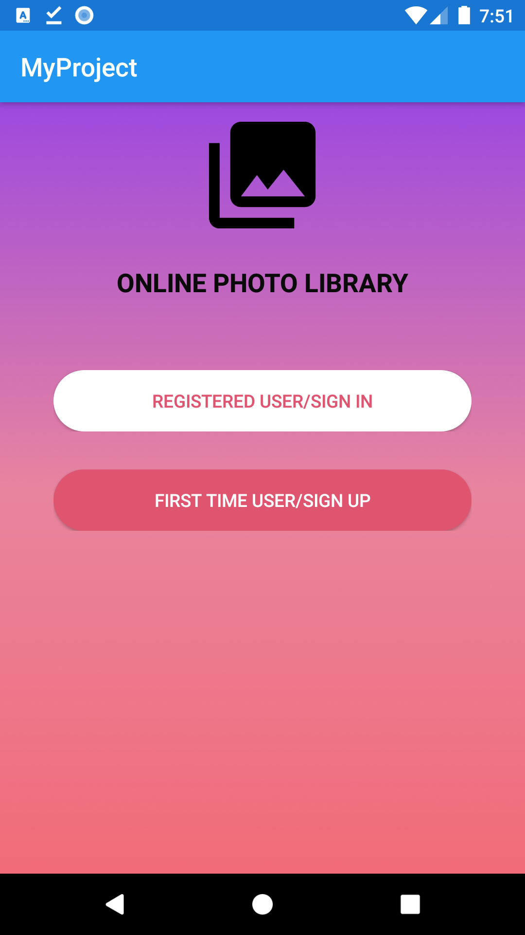
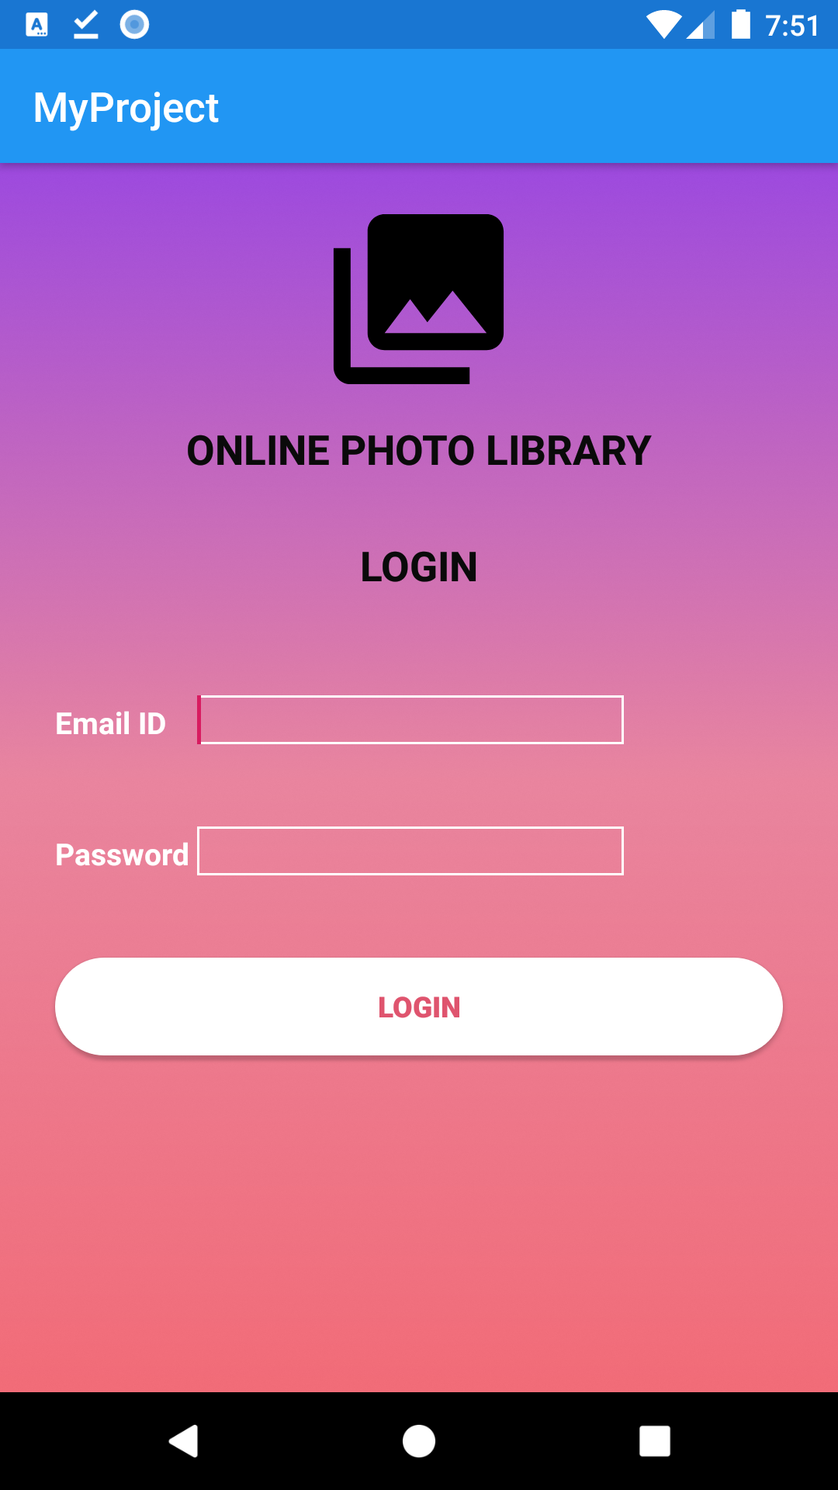
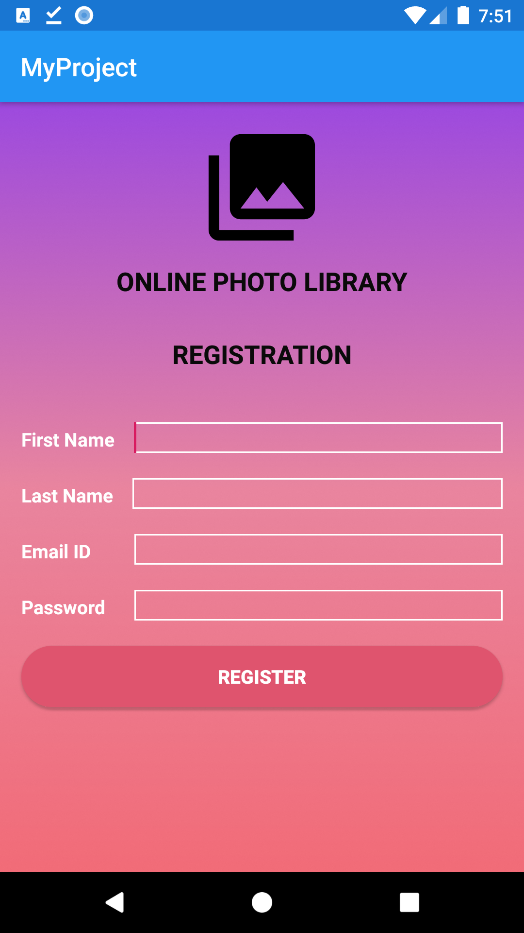
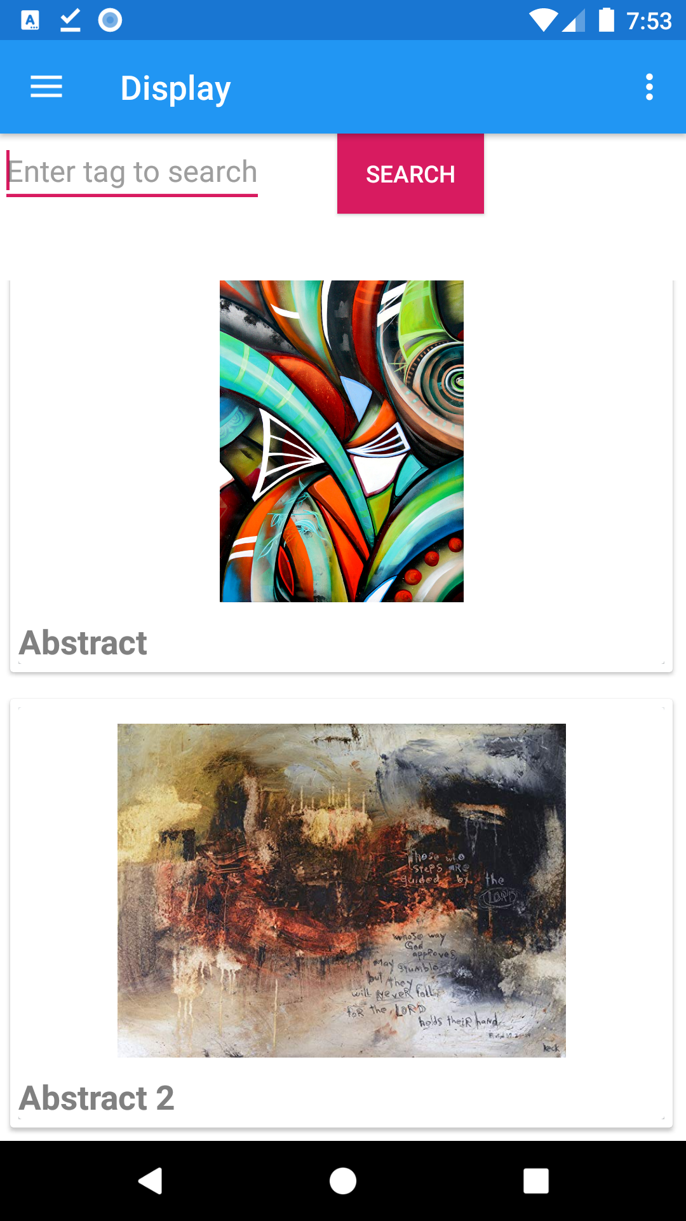
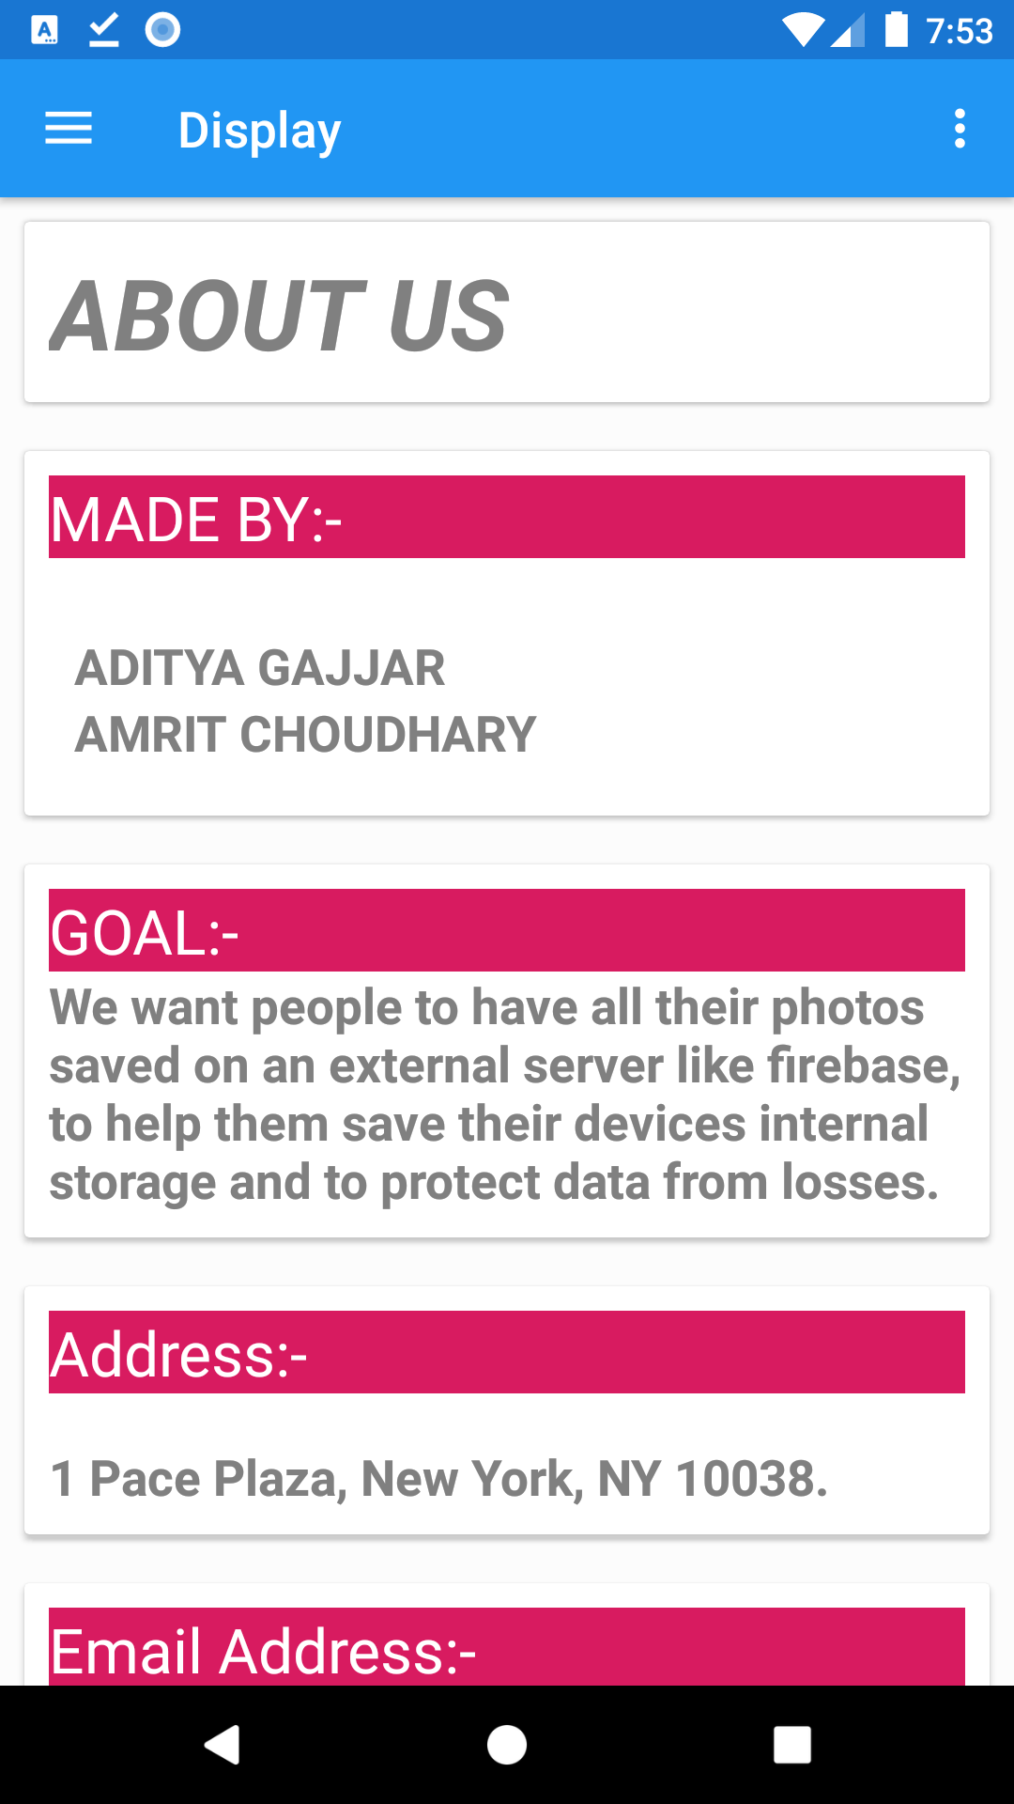
Screenshots and video link

Slide 8
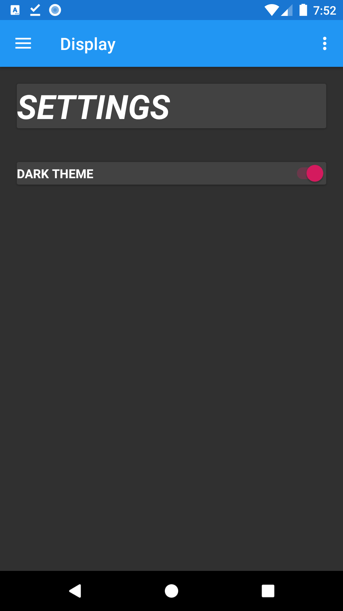
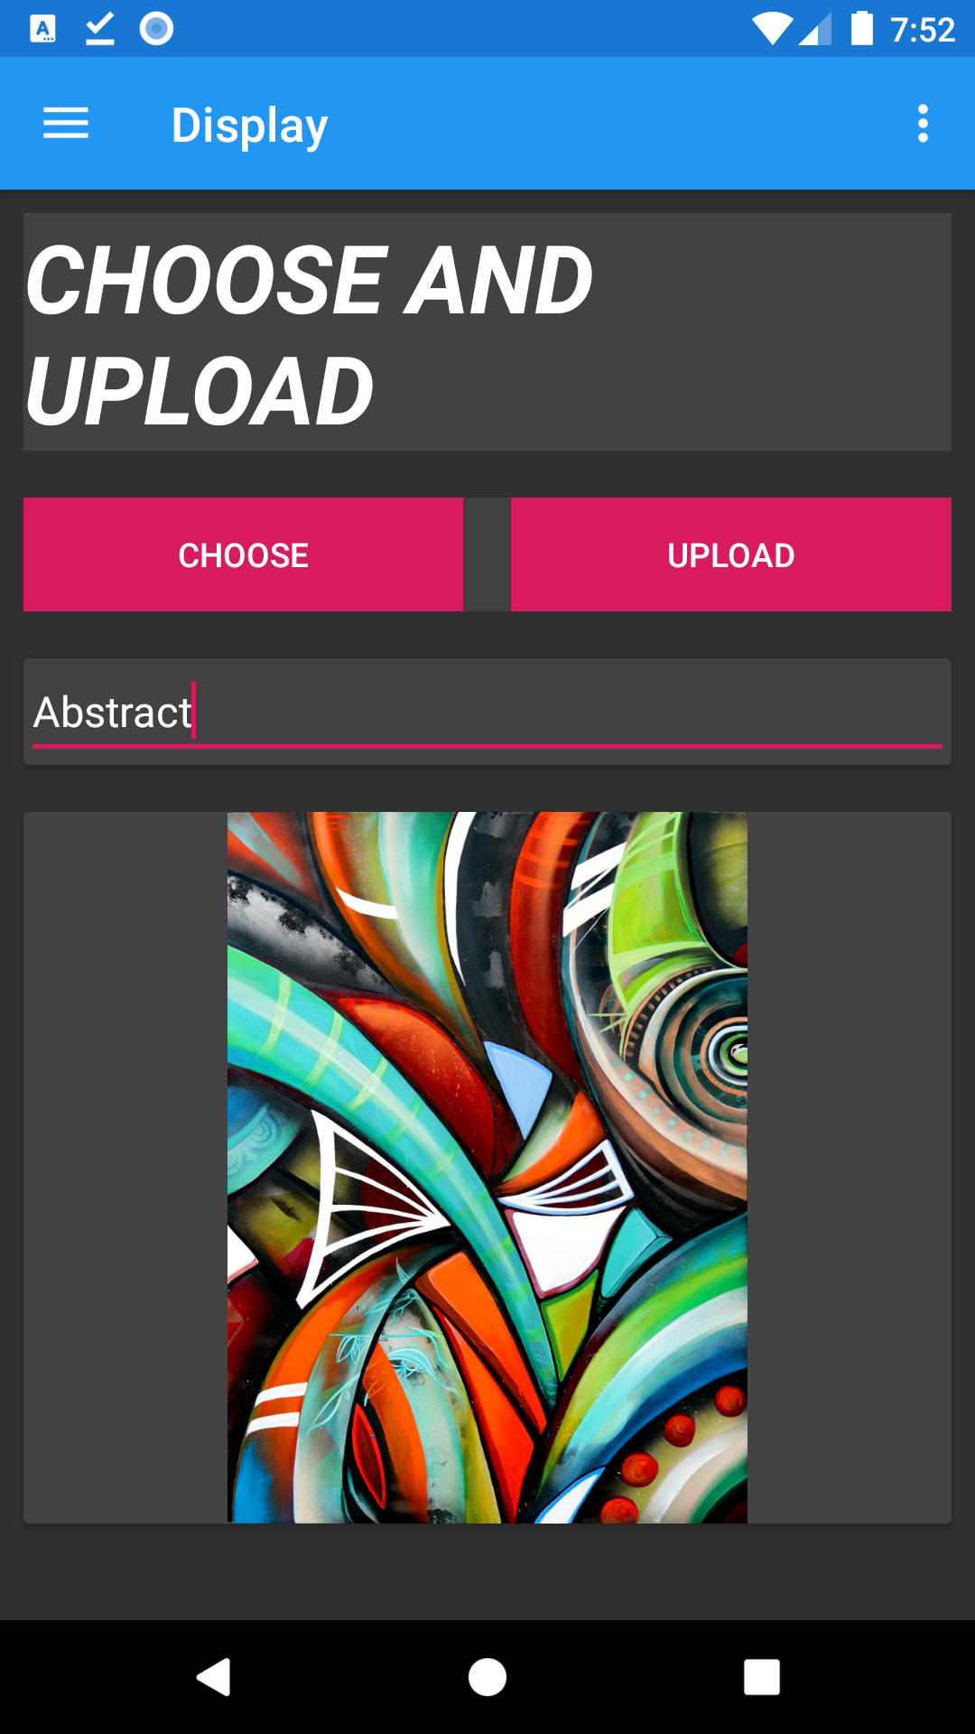
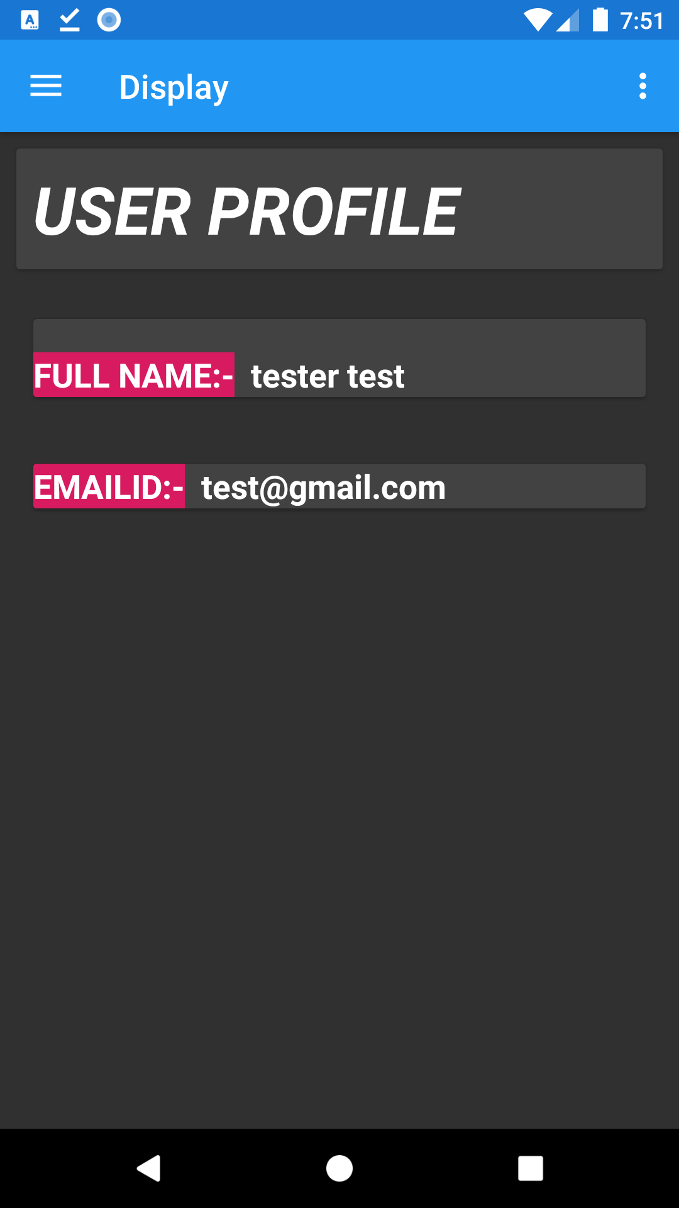
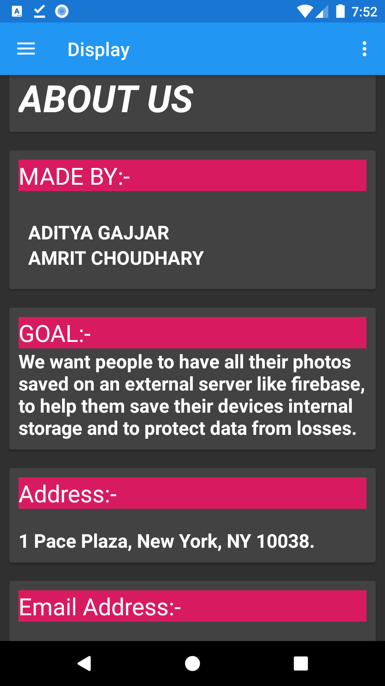
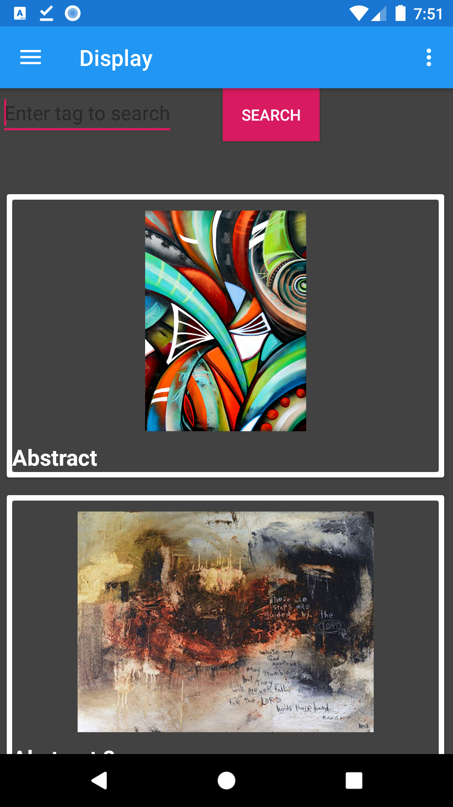
(DARK MODE THEME)
YOUTUBE LINK:-https://www.youtube.com/watch?v=SJpiLShuw-Q

Slide 9

Status of application
As of now we have completed and developed our proposed application outcome.
In the future we intend to work on selecting multiple images, help page and improve the UI.

Slide 10

Problems encountered while developing
Storing user data and image details in firebase.
Working with fragments in Navigation Drawer.
Applying Dark Theme: Reloading a Fragment Page.

Slide 11


